Slide 1

Name : Junaid Saeed.
Roll Number : 22p-9200
Section : BCS-2A1.

Slide 2

Bigo Live
Name : Junaid Saeed.
Roll Number : 22p-9200.
Section : BCS – 2A1.

Slide 3

Introduction to Bigo Live
•
Bigo Live is a live streaming platform that allows users to broadcast themselves and interact with viewers in real-time. It was launched in March 2016 by Singapore-based company BIGO Technology . The app has gained popularity worldwide, particularly in Southeast Asia, where it has become one of the most downloaded apps in countries like Indonesia, Thailand, and Vietnam.

Slide 4

Features of Bigo Live
•Bigo Live is a social media platform that enables real-
time interaction between users.
•The platform offers virtual gifts, which can be
exchanged for cash rewards.
•Users can join or initiate group chats and engage in
challenges and events such as talent.
•The virtual gift system incentivizes users to engage
with the platform, increasing its user retention and
growth.
•Bigo Live's emphasis on real-time interaction and live
events differentiates it from other social media
platforms that primarily focus on text-based
communication.

Slide 5

Live Streaming on Bigo Live
• One of the main features of Bigo Live is its
live streaming capabilities. Users can easily
start a live stream by simply clicking on the
camera icon and selecting their preferred
settings. Once live, users can interact with
their audience through live chat and receive
virtual gifts as a form of appreciation.
• Bigo Live also offers a variety of filters and
effects to enhance the live streaming
experience. From beauty filters to
augmented reality effects, users can add an
extra layer of creativity to their streams and
stand out from the crowd.

Slide 6

Bigo Live and Social Media Influencers
Bigo Live has also become a popular platform for social media influencers to connect with their followers and promote products.
Many influencers use the app to host live Q&A sessions, showcase their daily routines, and collaborate with other creators. This has led to a new wave of influencer marketing on the platform.

Slide 7

The Ultimate Destination for Live Streaming
Bigo Live is a live streaming platform that has taken the world by storm. It offers a unique and engaging experience for users who want to share their talents, skills, and interests with others. With its simple interface and easy-to-use features, Bigo Live has become the go-to destination for millions of people around the globe.
Whether you are a musician, dancer, gamer, or just someone who wants to connect with others, Bigo Live has something for everyone. You can join live broadcasts, interact with other users, and even earn money through virtual gifts and donations. So why wait? Join the Bigo Live community today and start sharing your passion with the world!

Slide 8

Monetization on Bigo Live
One of the unique aspects of Bigo Live is its monetization system, which allows users to earn money through virtual gifts sent by viewers during their broadcasts.
Bigo Live takes a percentage of these gifts as commission, while the rest goes directly to the broadcaster. Some users have even been able t to make a full-time income from their Bigo Live broadcasts

Slide 9

Controversies Surrounding Bigo Live
Despite its popularity, Bigo Live has faced criticism for its content moderation policies and the potential for inappropriate or harmful content to be broadcasted on the platform.
In some countries, such as India and Bangladesh, the app has been temporarily banned due to concerns about the spread of misinformation and dangerous behavior among users.

Slide 10

Virtual Gifts on Bigo Live
• Another unique feature of Bigo Live is its
virtual gifting system. Users can purchase
virtual gifts using in-app currency and send
them to their favorite broadcasters as a way of
showing support and appreciation. These
virtual gifts can range from simple emojis to
more elaborate animations such as a flying car
or a yacht.
• In addition to being a fun way to engage with
broadcasters, virtual gifts also serve as a source
of income for many content creators on the
platform. Popular broadcasters can earn
significant amounts of money through virtual
gift donations from their fans.

Slide 11

Video Chat on Bigo Live
• Bigo Live also offers a video chat feature,
allowing users to connect with each other
through one-on-one video calls. This feature
is particularly useful for those looking to
make new friends or practice their language
skills with native speakers.
• Video chat on Bigo Live is easy to use, with
users simply needing to click on the video
chat icon and select a potential chat partner.
The app also offers real-time translation,
making it easier for users to communicate
with each other even if they don't speak the
same language.

Slide 12

Why People Like Bigo Live
• One of the main reasons why people like
Bigo Live is because it's easy to use. The
platform has a user-friendly interface that
allows even beginners to navigate and start
streaming without any hassle. This makes it
accessible to a wider audience, including
those who are not tech-savvy.
• Another reason why people like Bigo Live
is because there are lots of gifts. Viewers
can send virtual gifts to their favorite
broadcasters as a way of showing
appreciation. These gifts can be exchanged
for real money, which makes it an attractive
option for those looking to make some extra
cash.

Slide 13

Community on Bigo Live
Bigo Live has created a vibrant and supportive community for its users. Many users have formed close friendships through the app, bonding over shared interests and experiences. The app also provides a platform for users to showcase their talents and gain recognition from a global audience.
In addition to individual broadcasters, Bigo Live also hosts online events and competitions. These events bring together users from all over the world, creating a sense of community and shared purpose. Whether it's a dance competition or a charity fundraiser, these events allow users to come together and make a positive impact.

Slide 14
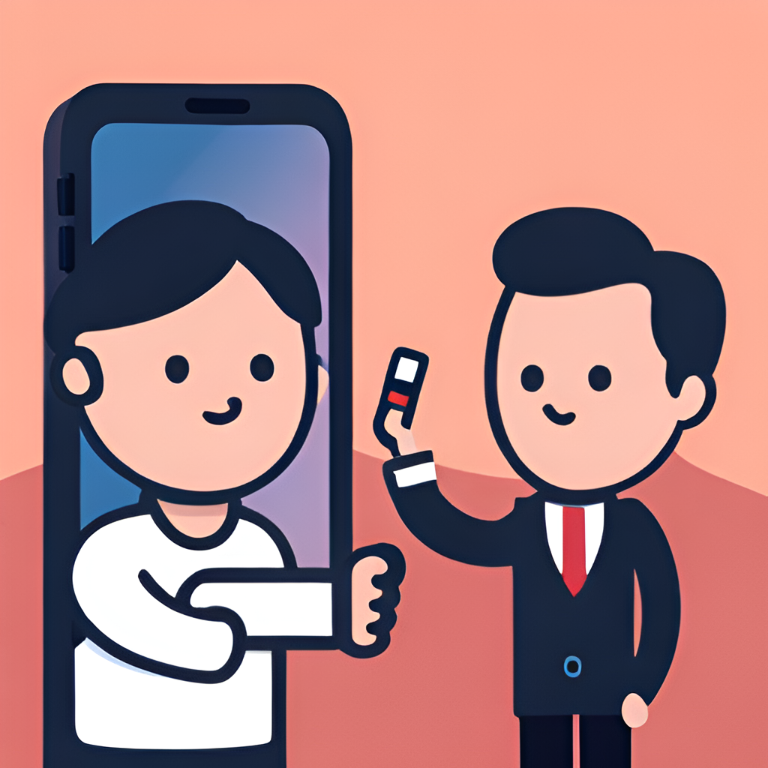
Safety and Privacy on Bigo Live
As with any social media platform, safety and privacy are important concerns for Bigo Live users. The app has implemented several measures to protect its users, including a reporting system for inappropriate behavior and content. Users can also block and report other users who are behaving inappropriately.
Bigo Live also has strict guidelines regarding nudity, sexual content, and hate speech. Users who violate these guidelines can be banned from the app. Additionally, the app does not allow users under the age of 18 to use its services without parental consent.

Slide 15

Cons of Using Bigo Live
• Another downside to using Bigo Live is the
lack of privacy. The platform requires users
to share their location, which can be a
security risk for some individuals.
Additionally, users may not be aware that
their streams are being recorded and shared
without their knowledge or consent.
• Another issue with Bigo Live is the
potential for addiction. The platform's
addictive nature can lead to users spending
excessive amounts of time on the app,
neglecting other important aspects of their
lives. This can have negative consequences
on mental health, relationships, and
productivity.

Slide 16

Pros of Using Bigo Live
• One major advantage of using Bigo Live is that
it is user-friendly. The interface is easy to navigate,
and users can quickly find the features they need.
This makes it accessible to a wide range of people,
including those who may not be tech-savvy.
• Another benefit of Bigo Live is its wide range of
virtual gifts. Users can send gifts to their favorite
streamers, which can help them earn money and
gain recognition. Additionally, the group video
chat feature allows users to connect with friends
and family from around the world, making it a
great tool for staying in touch. Finally, Bigo Live's
global reach means that users can connect with
people from all over the world, expanding their
social network and cultural horizons.

Slide 17

Bigo Live and Social Media Trends
Bigo Live has become a major player in the world of social media, particularly among younger generations. Its focus on live streaming and community-building has resonated with users who are looking for more authentic and interactive online experiences.
Additionally, Bigo Live has embraced trends such as influencer marketing and brand partnerships. Many popular broadcasters on the app have been able to monetize their content through sponsorships and collaborations with brands. This has led to a new wave of social media influencers who are building their careers on platforms like Bigo Live.

Slide 18

Future of Bigo Live
As of 2021, Bigo Live continues to expand its user base and introduce new features, such as virtual reality experiences and improved content moderation tools.
The company has also expressed interest in exploring opportunities in e-commerce and advertising, leveraging its large audience and social media influence.

Slide 19

Safety Measures on Bigo Live
• To address the concerns surrounding
inappropriate content and behavior on the app,
Bigo Live has implemented several safety
measures. For one, it has a team of moderators
who monitor and review all live streams and user-
generated content. Users can also report any
inappropriate behavior or content they come
across.
• Bigo Live also has strict guidelines and policies
regarding acceptable behavior and content on the
app. Users who violate these guidelines can face
consequences such as account suspension or
termination. Additionally, the app has age
restrictions and requires users to verify their
identity before using certain features.

Slide 20

Conclusion
• In conclusion, Bigo Live is a popular live
streaming app that allows users to connect
with others and engage in various
activities and events. While it has faced
some controversies over the years, the
app has implemented several safety
measures to ensure a positive user
experience. Overall, using Bigo Live can be
a fun and rewarding way to connect with
others and share your interests and talents
with the world.

Slide 21


